Slide 1
Atlas Itinerary
By Gabriel Taylor, Dustin Zook, Sorelle Djuissi, Gabriyel Sorensen

Slide 2
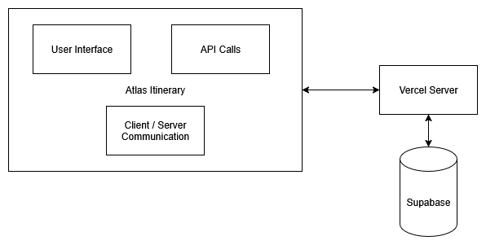
Block Diagram

Slide 3
Storyboard

Slide 4
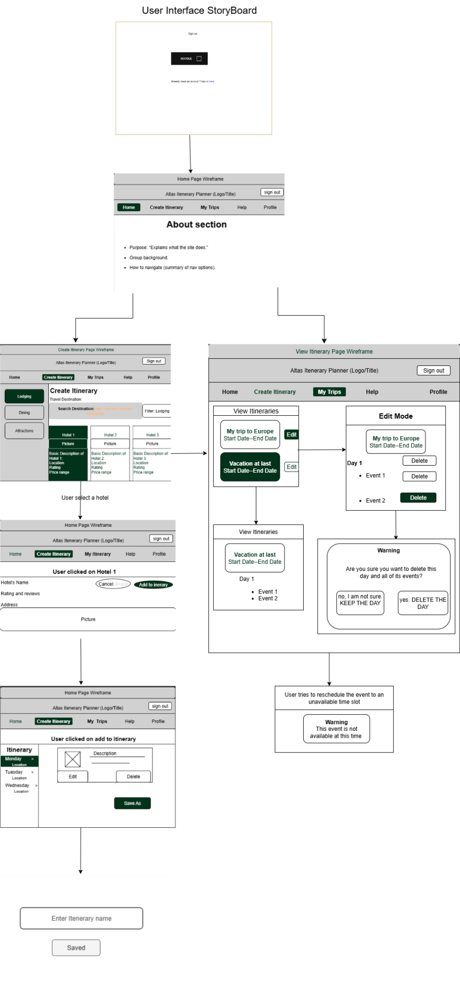

Slide 5
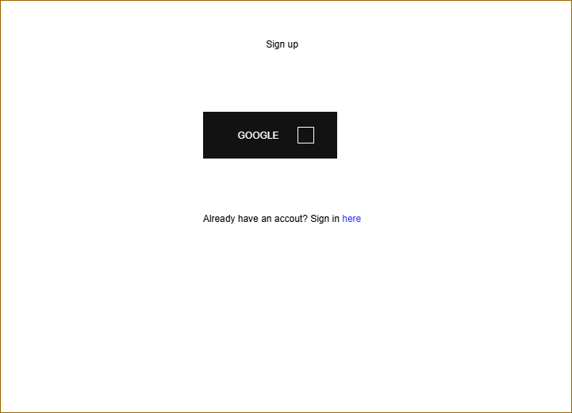
Sign-up and sign in page
Google API backbone
Link to Sign-in page

Slide 6
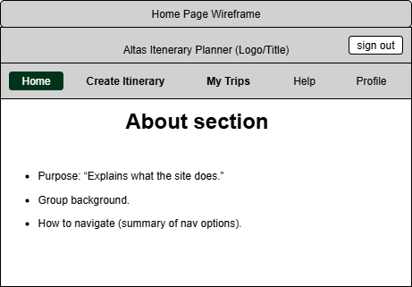
The Home Page
About Section
Instructions
Personnel
Nav Bar

Slide 7
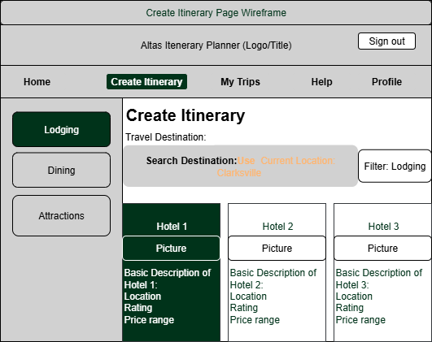
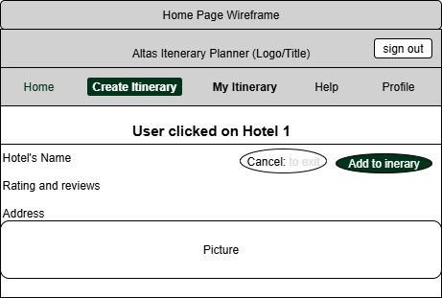
Create Itinerary
Travel destination
Geolocating
Location categories
Subcategories in the filter

Slide 8
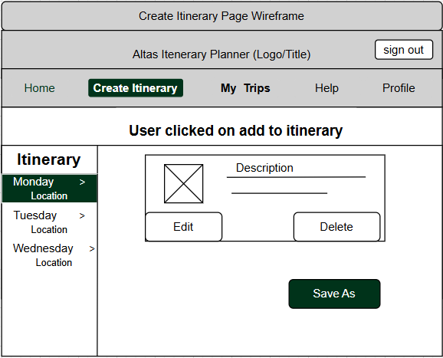
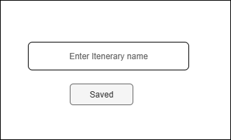
Successful Completion

Slide 9
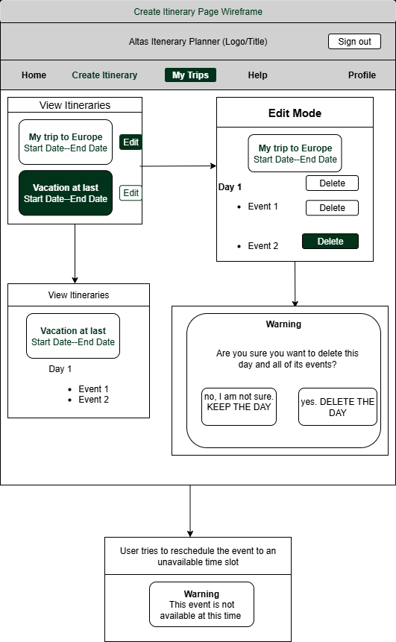
View Itinerary
Empty Page
Card Presentation (and Contents)
Expanded cards
Edit mode (both event and day)
Warning

Slide 10
The Components

Slide 11
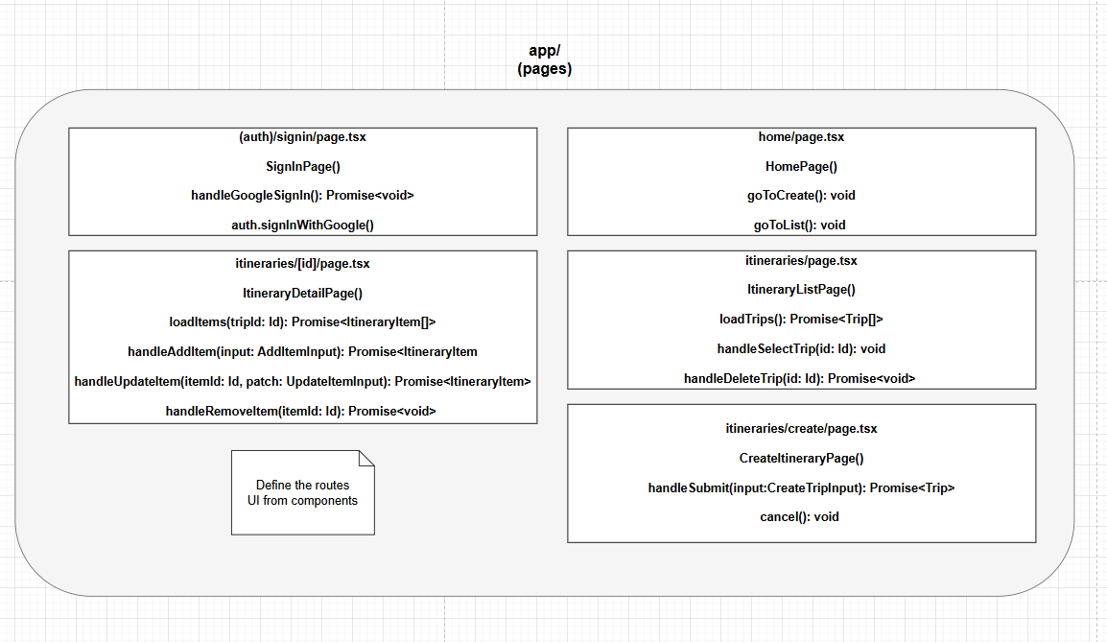

Slide 12
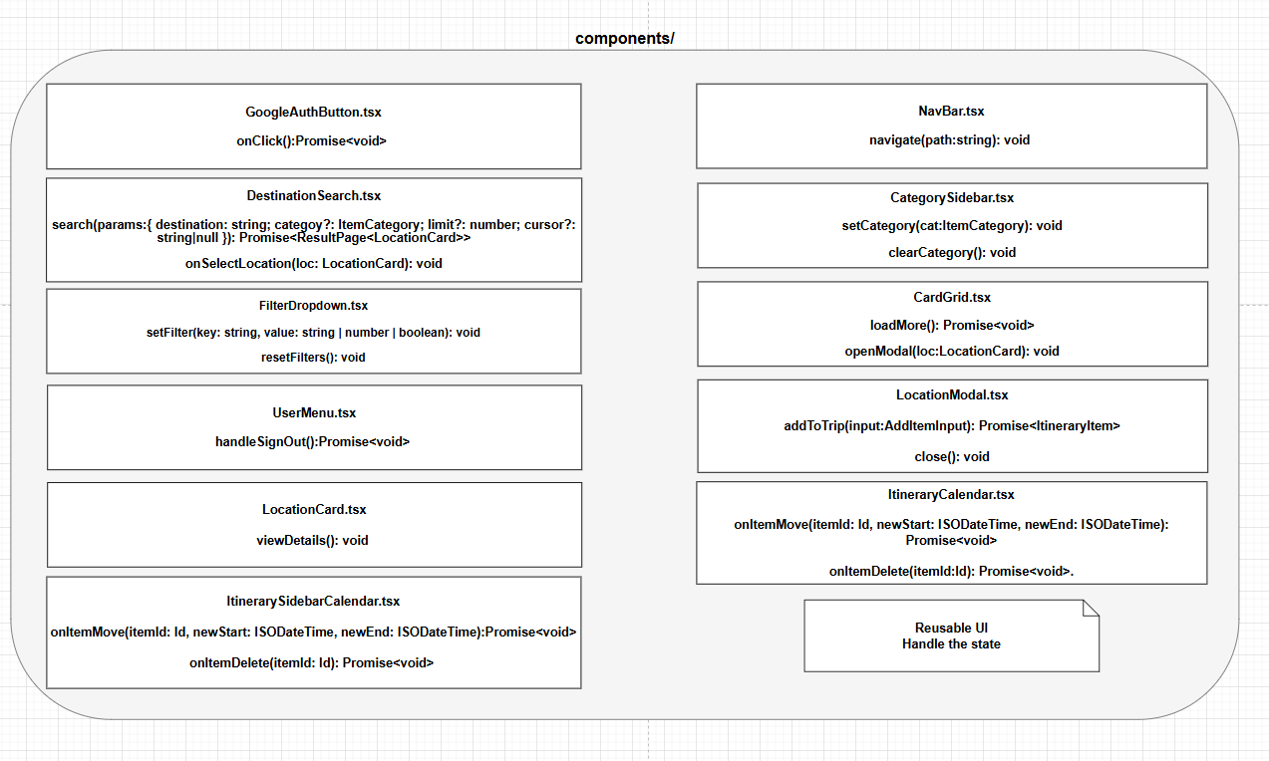

Slide 13
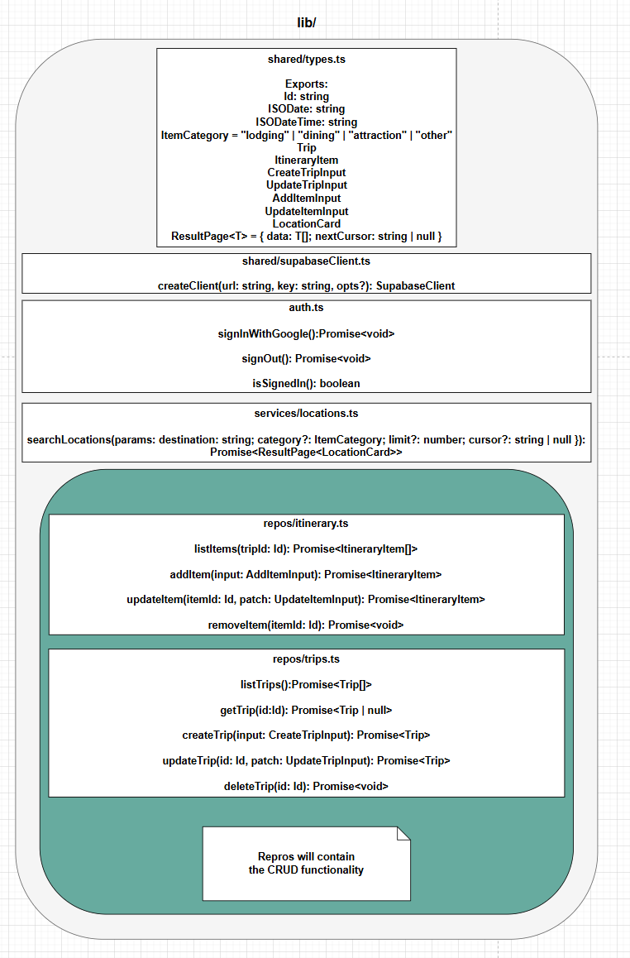

Slide 14
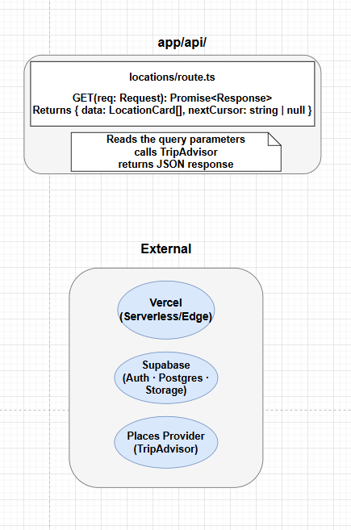

Slide 15
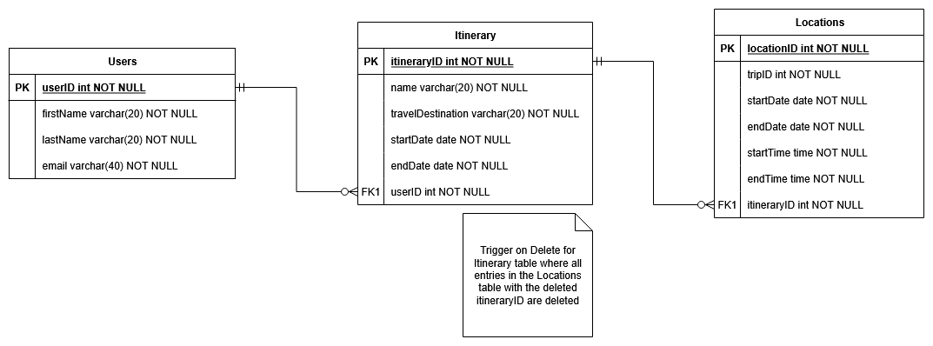
Storage Documentation - ER Diagram

Slide 16
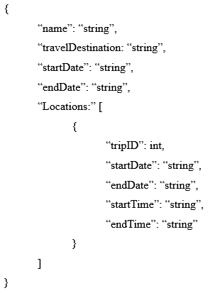
Message Documentation - Save Itineraries

Slide 17
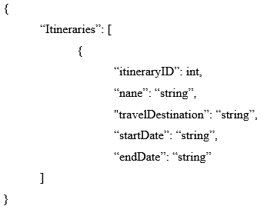
Message Documentation - View Itineraries

Slide 18
Questions?

